Slide 1
Team 68 Final Video Presentation
- Nihar Moramganti​
- Yuchen Hu​
- Michael Cardenas​
- Linh Dang​
Analyzing the Impact of Macroeconomic Factors on Real Estate: A Study of CPI, Interest Rates, and Home Inventory

Slide 2
Objective/Problem
Purpose
We want to find which variables have the most influence on housing prices so we can better predict housing prices
We want to explore how these drivers influenced housing prices during COVID-19 and also how these factors played pre-pandemic as well
Want to build a model that would be the best fit for determining the most influential variables that will predict future housing prices
Business Justification
Predict housing prices so buyers know when to buy homes at the right time
Open up investment opportunities for consumers that want to buy property
President or Congress can pass laws that affect home inventory

Slide 3
Research
Forecasting ERIT Returns
Multiple factors yield best predictions: GDP, Inflation,Short-Term Interest Rates,Dividend Yields,Bonds
Affects supply and demand, which impacts asset prices
No best predictor, but combination of predictor variables
Forecasting Real Estate Prices
Difficulty predicting real estate prices: Heterogeneity,High Transition Costs,Monetary Policy
Predictors such as rent-price and income-price demonstrate real estate returns
Construction costs and Regulatory restrictions also play big role in real estate returns
Housing Prices and Inflation
Long Term Increases: Restrictions on local zoning and affordable housing
Pandemic Increases: Prices of iron,steel,and lumber increased by over 70% in the past year
Other housing price issues due to supply constraints or shortages in housing market

Slide 4
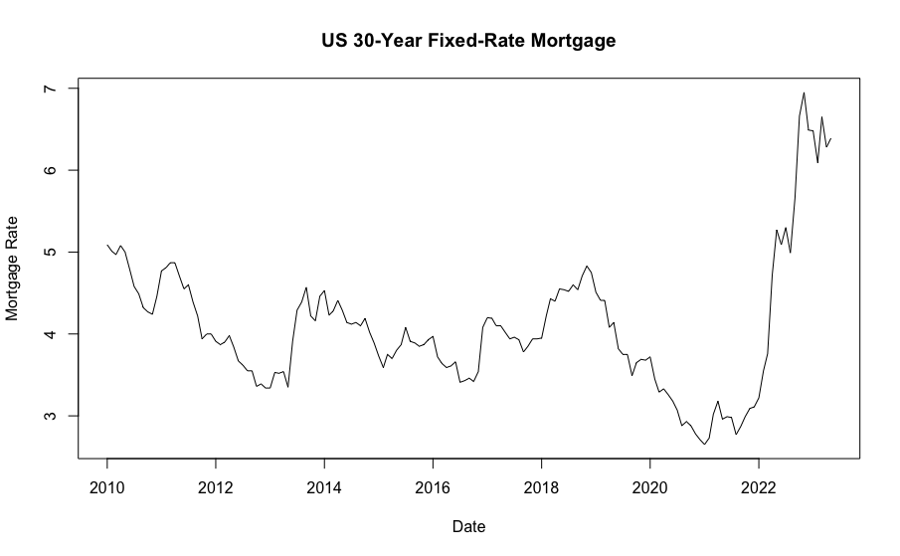
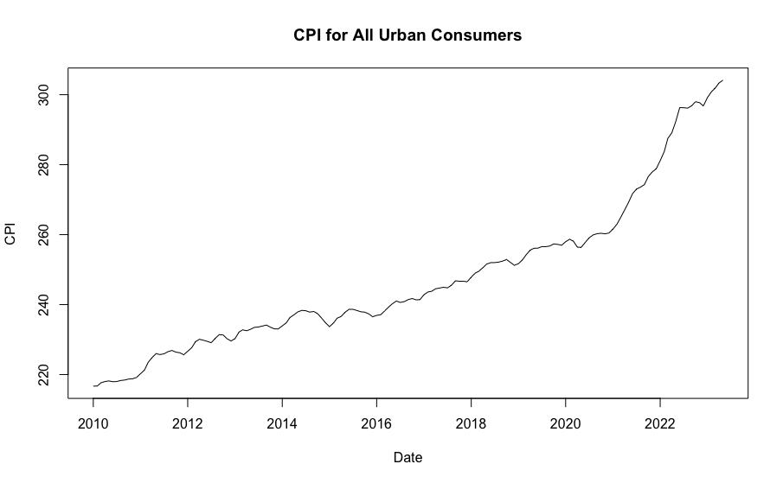
Data Exploration and Initial Hypothesis
Data source
30-Year Fixed Rate Mortgage Average in the United States (Federal Reserve Bank of St. Louis)
Consumer Price Index (CPI) for All urban Consumers (Bureau of Labor Statistics Data)
Active Listing Housing Inventory in the United States (Federal Reserve Bank of St. Louis)
Annual Estimates of the Resident Population for Counties (Census)
Zillow Home Value Index for All Home (SFR, Condo/Co-op) (Zillow research data)
Data Cleansing
Standardizing the Time Series
Selecting appropriate Time Frame
Focus on 16 counties with over 2M population
Initial Hypothesis
Positive Correlation: Housing Value vs. CPI & Population
Negative Correlation: Housing Value vs. Mortgage Rate & Active Listing

Slide 5
Approach/Methodology
Variable Selection
Various linear regression models with different variables
Chose the model with highest adjusted R-squared and lowest p-values for coefficients
Resulting Variables: CPI, 30-year average Mortgage Rates, Active Listings, population, and County
Creating the models
Split data into training, validation, and testing sets
Analyzed various models such as ARIMA, linear regression, and random forest regression
Evaluated and optimized the models

Slide 6
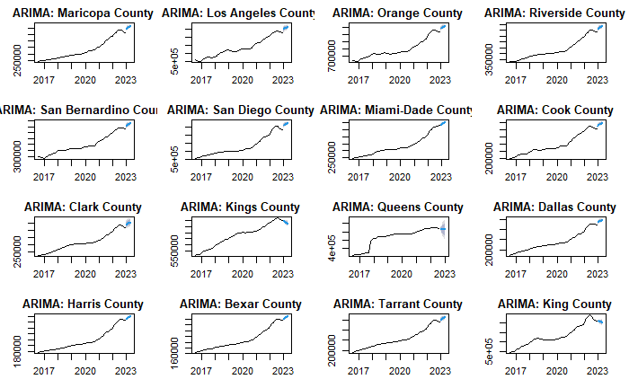
ARIMA
Created ARIMA forecasts through the first 5 months of 2023
Resulted in average RMSE of 34,458.19
Accurately forecasted price by county

Slide 7
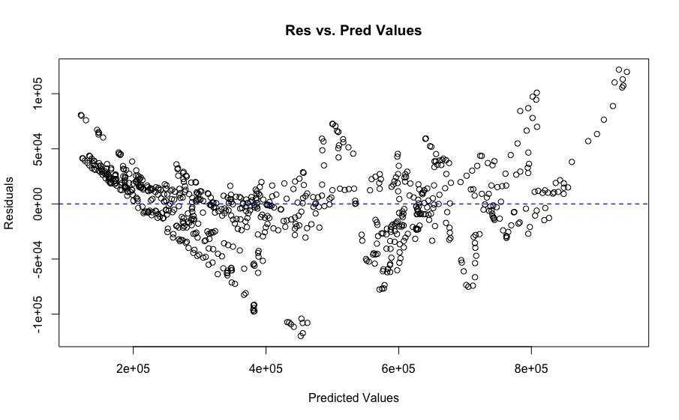
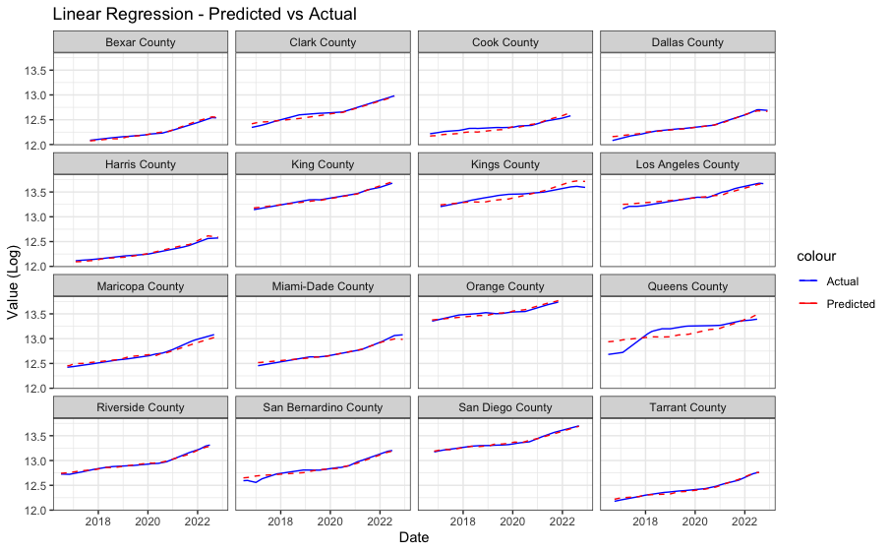
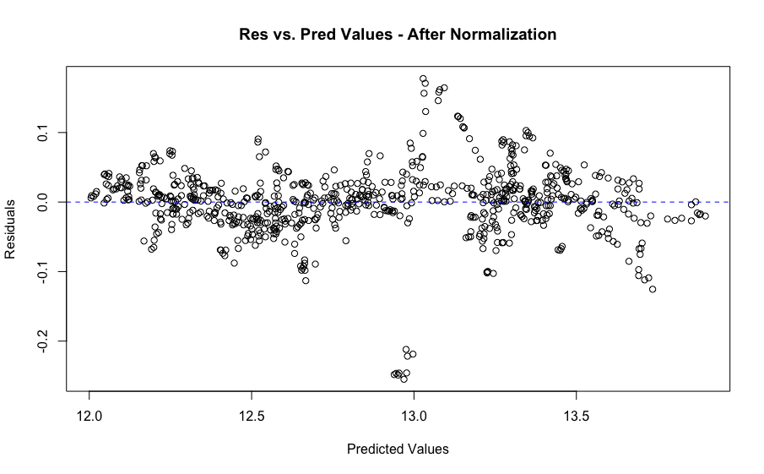
Linear Regression
Multivariate model with all four variables had better RSME
Heteroscedasticity - Log transformation
Conduct correlation matrix analysis
Predicted vs. Actual Plot by Counties

Slide 8
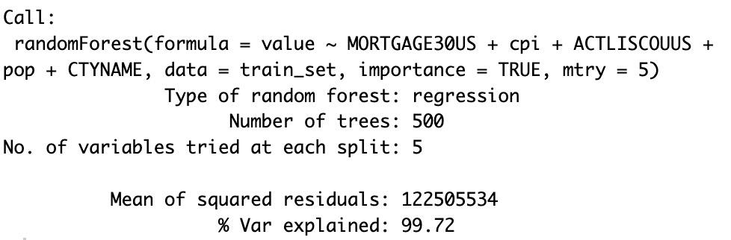
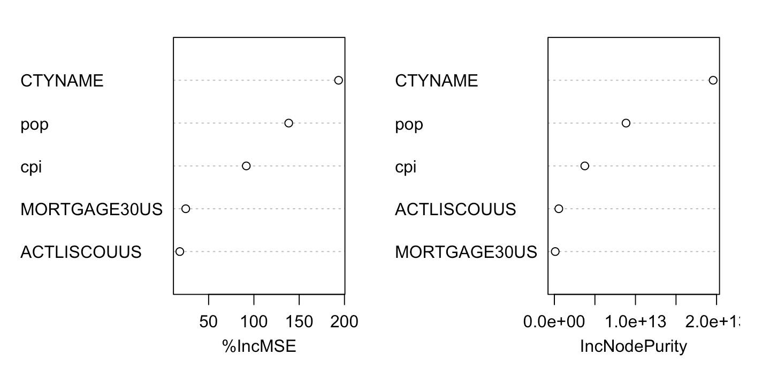
Random Forest
Parameter selection based on industry best practices
The model explains almost all of the variance
Most important feature is CTYNAME
Lowest importance features are mortgage interest rates and active listings

Slide 9
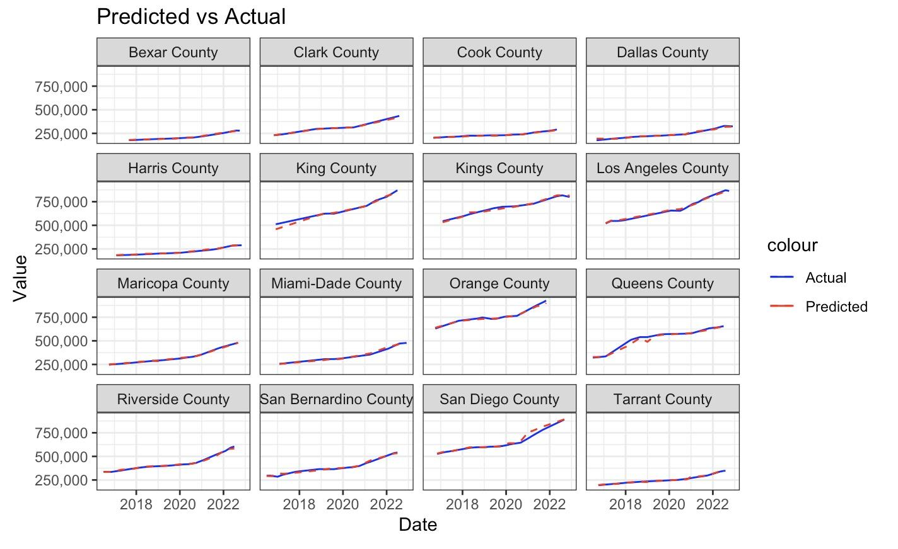
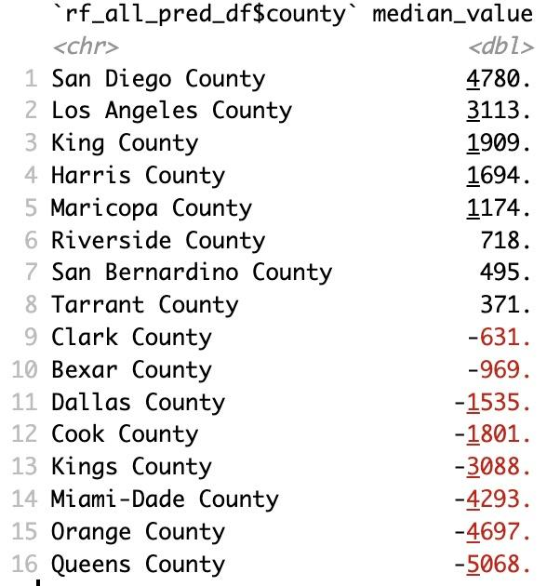
Random Forest
Average RMSE is 6,553.69
San Diego County is most undervalued
Queens Count is most overvalued

Slide 10
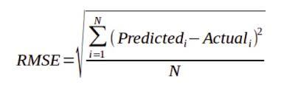
Model Comparison
Measured average root mean square error (RMSE) using the validation set to compare model performances
Fit for Random Forest seems adequate even with the high % variance explained
Model | RMSE
ARIMA | 34,458.19
Linear Regression | 32,516.82
Random Forest | 6,553.69

Slide 11
Conclusion
Random Forest is able to most accurately account for non-linearity of data predictor variables when forecasting real estate prices as opposed to other models
A holistic approach of combining multiple models can provide the most insight when making market related decisions
Further research is recommended using alternate models, larger time horizons, and focusing on different geographic locations

Slide 12

Citations
Serrano, Camilo, and Martin Hoesli. “Forecasting Ereit Returns.” Taylor & Francis Online, 18 June 2020, www.tandfonline.com/doi/abs/10.1080/10835547.2007.12089784.
Bernstein, Jared, et al. “Housing Prices and Inflation.” The White House, Sept. 2021, www.whitehouse.gov/cea/written-materials/2021/09/09/housing-prices-and-inflation.
Ghysels, Eric, et al. “Forecasting Real Estate Prices.” Handbook of Economic Forecasting, Elsevier BV, 2013, pp. 509–80. https://doi.org/10.1016/b978-0-444-53683-9.00009-8.

